Slide 1
Immigration

Slide 2
The gateways to america
Ellis Island
New York
What happened at Ellis Island?
Angel Island
San Francisco

Slide 3
Groups that came to America
1840-1860
10 million Irish
to America
Between 1880-1920
Chinese
Czech
Greek
Polish
Italian
Japanese
Russian

Slide 4
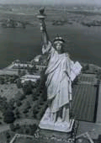
Why did they leave their homeland?
Europe was overcrowded
To escape political persecution
Religious Freedom
Economic Opportunities
Famine
Bad harvests

Slide 5
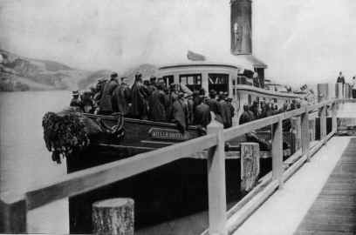
The Trip to America
Most immigrants travelled to America with steerage tickets
Lowest part of the ship, very crowded, no bathrooms,
Trip was characterized by disease and hunger in many cases

Slide 6
What challenges did Immigrants face in America?
Education-language and citizenship process
Where to live
Employment
Prejudice and discrimination-Nativism-favoring American born people
Immigration laws like the Chinese Exclusion Act
Family tensions

Slide 7
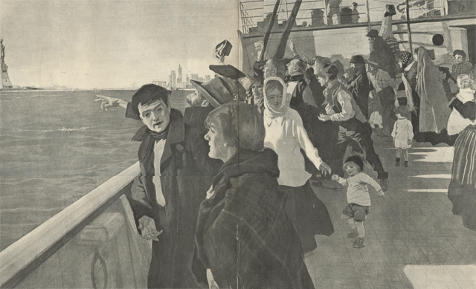
Photo Analysis

Slide 8
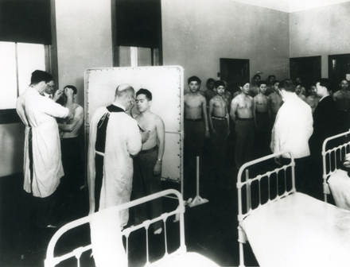
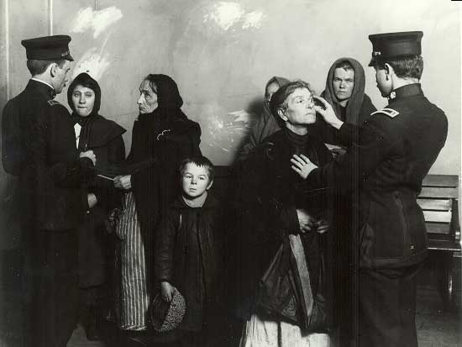
Photo analysis

Slide 9
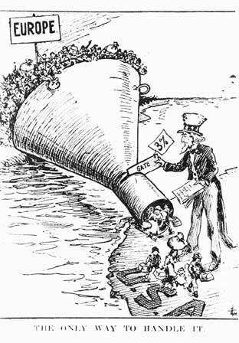
Cartoon Analysis

