Slide 1
The Media

Slide 2
The Media State
United States is world’s first media state
Each year, the average American adult spends
  1824 hours at work
  2737 hours sleeping
  3256 hours exposed to the media
Americans experience multiple media exposures simultaneously
Notes:
Those who use social media aren’t just news consumers, they function as news conduits by linking others to media they consider important.

Slide 3
The Media’s Functions
Entertainment
Reporting the news
Identifying public problems
  Setting the public agenda
  Investigative function
Socializing new generations
Providing a political forum
Making profits
Notes:
Americans most frequently cite television as their primary news source, followed by the Internet, then newspapers. A larger percentage of young people (six in ten) rely on the Internet and television equally. However, the greatest number of television and radio hours are devoted to entertainment, not news.
The top news story in 2009 was the condition of the U.S. economy. Other top stories included the escalating Afghanistan war and the health care debate.

Slide 4
History of the Media in the U.S.
Rise of the political press
Development of mass-readership newspapers
Popular press and yellow journalism
Age of the electromagnetic signal
Notes:
Political events leading up to the American Revolution changed the nature of the press from printers of official documents and notices of public events to chroniclers of the disputes with Great Britain. The Federalist/Anti-Federalist battle led to newspaper support of political agendas. By the 1850s, newspapers began to realize that circulation would increase through nonpartisan coverage.

Slide 5
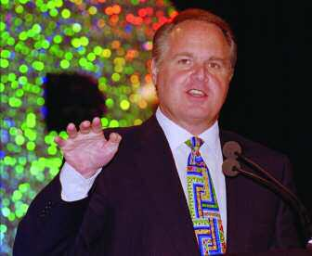
Revolution of Electronic Media
Cable TV
  Narrowcasting
Talk show politics
The Internet
  Broadcasting
  Blogging
  Podcasting
  Social media
Rush Limbaugh
AP Photo/Lennox McLendon
Notes:
In 1980, CNN was launched by Ted Turner as the first 24-hour all news network. It is available in over 93 million U.S. households, and reaches nearly 1 billion people around the globe.
A new type of narrowcasting is interactive, allowing the viewer to influence the content being displayed, sometimes through use of a touch screen. A more traditional type of one-way narrowcasting is familiar to all cable viewers on networks such as ESPN, MTV, CSPAN, Telemundo.

Slide 6
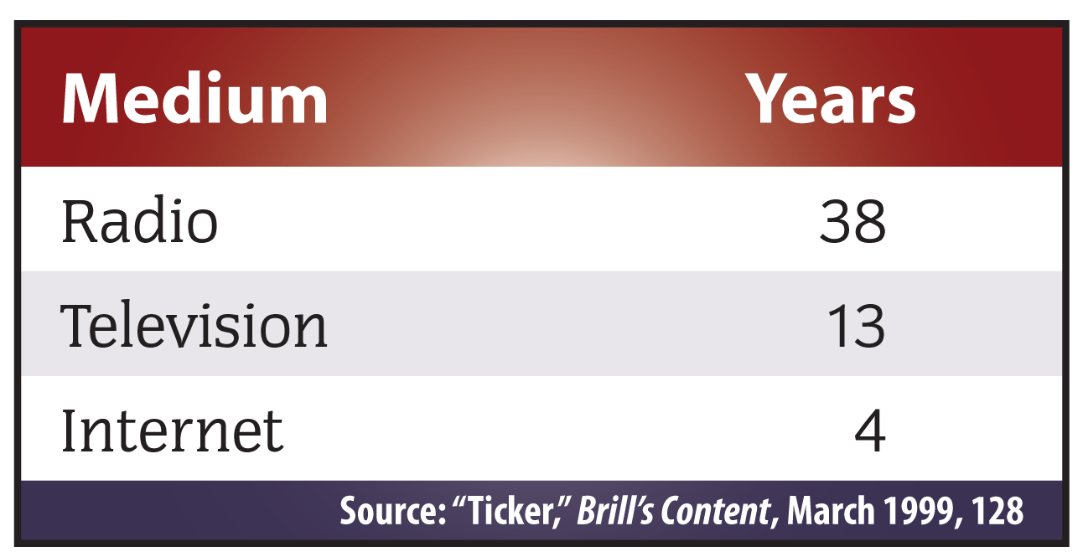
Number of Years After Introduction to Attract Fifty Million Users

Slide 7
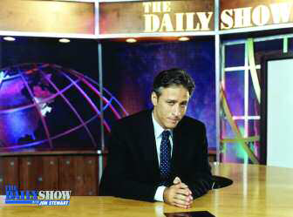
The Primacy of Television
Currently the most influential type of media is television.
  Internet is gaining quickly
In 1963, the major networks devoted only 11 minutes a
day to national news (a 15-minute show minus ad time). Today it’s about three hours.
Many all-news channels are also available.
The Daily Show often features political guests.
Courtesy of The Daily Show
Notes:
However, the viewership of the major network’s evening news programs continues to fall. Combined, the three major networks reach about 22.8 million viewers each evening, down about 1 million viewers each year in each of the past 25 years, according to Nielsen Media Research.

Slide 8
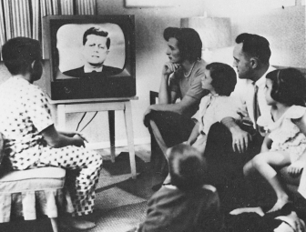
The Primacy of Television (cont)
Television influences the political process
  Viewers can actually see news and history as it is happening
  Relies more on pictures than words
  Pressure to sensationalize or trivialize
The Kennedy-Nixon debates in 1960
The Library of Congress
Notes:
Over 70 million viewers tuned in to watch the Kennedy-Nixon debates in September and October, 1960. Although the candidates were fairly evenly matched, Kennedy seemed more appealing and confident to television viewers. Radio listeners during the first debate thought Nixon had won. Powerful visual perceptions helped solidify voter’s opinions, and have played a role ever since.

Slide 9
The Media and
Political Campaigns
Voters now receive most information from electronic media, especially television.
Three types of campaign television coverage
  Advertising
  Management of News Coverage
    Planning political events to accommodate the press
    Developing a good working relationship with reporters
    Convincing the media to put the right “spin” on a story
  Political Debates
Notes:
The NY Times reports that $2.6 billion was spent on political advertising by candidates and interest groups at all levels in 2008. The majority, about $2 billion, was spent on local broadcast television, up about 34% from the 2004 presidential election year.
Challengers usually have more to gain from a debate than incumbents.

Slide 10
The Media and Political
Campaigns (cont)
“On the Internet, nobody knows you’re a dog.”
Political campaigns and the Internet
Rise of social media
© The New Yorker Collection 1993
Steiner from cartoonbank.com. All rights reserved.
Notes:
In recent campaigns, the Internet has played an increasingly prominent role, as candidates use websites to convey their messages as well as to solicit contributions. The Internet has also been a useful tool for voters, with one study reporting that one-fifth of voters had used the Internet to obtain information about elections.

Slide 11
Media’s Impact on Voters
Has the greatest impact on the truly undecided
  “Horse race” coverage predominates
Most voters have preconceived ideas about candidates and issues
  Selective attentiveness
Notes:
Candidates package an image through carefully planned appearances and political advertisements. However, the overwhelming amount of information received from different media make it difficult to determine exactly how these images impact voters. Minimal effects theorists believe that other deep-seated, long-term factors (such as party identification) have much greater influences on voters’ choices. They believe that people filter news stories and advertising through their own partisan perspectives, and tend to remember only that which is more consistent with their beliefs (selection retention.)
Agenda setting theorists believe that the media are very influential in telling the public what to think about. In other words, if there are many news stories about the high cost of health care, viewers will see this as an important issue. And if the public is interested, then political candidates discuss the issue and form an opinion.

Slide 12
Atomization of the Media
Increasing concentration of national media, but audience fragmentation leads to loss of influence
  Major media have lost dominance
  Minor players playing increasing role
Lines becoming blurred between entertainment and politics
  Comedy shows often sole source of news
  Fringe media often captures public attention
Notes:
Technology has contributed to the atomization of the media, especially in the development of cable television and the Internet. Breaking news appears immediately on the Internet, thus voters are less likely to rely on the evening news or their morning newspaper. Talk radio and cable news programs have also capitalized on the current populist backlash against “Washington insiders.”

Slide 13
The Media and the Government
By focusing attention on controversial actions, the media can sometimes pressure the government into changing course.
© AP/ Wide World Photos
Notes:
In its role as a watchdog, the media have been referred to as the fourth branch of government, or “the fourth estate.”

Slide 14
Relationship Between the Media and Recent Administrations
Ronald Reagan
  Dubbed “The Great Communicator, ” but could be fuzzy on specifics
Bill Clinton
  Knowledgeable and charming; but media often hostile
George W. Bush
  Tried to use AND avoid media
Barack Obama
  Cerebral and controlled; technologically savvy
Notes:
Reagan idolized FDR, and was dubbed “the Great Communicator." Could be fuzzy on facts but was great with overarching themes. As an actor, he knew how to use TV to his advantage.
Clinton emulated Reagan and tried to reach out to citizens with his themes. Knowledge and charm made him especially effective in one-on-one situations. Clinton, had many opponents, however, and faced a hostile media environment.
George W. Bush alternately tried to use and avoid the media. Not as comfortable in front of TV cameras, Bush preferred to work behind the scenes. His strength is to speak to moral clarity.
Obama is a calm and confident communicator. Media opportunities are highly structured, and he is skilled in the use of technology and social media. Obama’s style is sometimes too cerebral and controlled.

Slide 15
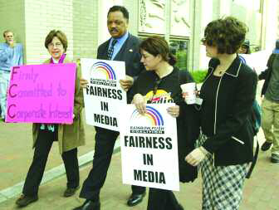
Government Regulation of the Media
The Federal Communications Commission (FCC) has far more control over the broadcast media than it does over print.
Reverend Jesse Jackson leads a protest outside FCC headquarters.
Chris Kleponis/Bloomberg News/Landov
Notes:
The FCC was created in 1934 to regulate electronic media. In FCC v. Pacifica Foundation (1978), the Supreme Court upheld the FCC’s power to regulate the broadcast of so-called indecent material. The case stemmed from a parent’s complaint that his son heard comedian George Carlin’s “Filthy Words” routine aired over a public radio station owned by Pacifica.

Slide 16
The Press: Legal and Constitutional Issues
Prior Restraint
  For media, this equals censorship
  New York Times v. United States (Pentagon Papers)
Free Press and Fair Trial
  First Amendment guarantees
Libel: written defamation
  Malice must be present
Notes:
The principle of truth is the historic defense against changes of libel, dating back to the 1735 trial of a newspaper publisher who allowed articles critical of the British-appointed governor of New York.

Slide 17
The Press and the Government
Symbiotic/Adversarial relationship
  Adversaries who need each other
  News leaks and “backgrounders”
  Scoops
  Press conferences
Investigative reporting
The Freedom of Information Act
The Press as Target
Notes:
A famous example of investigative reporting is the work of Bernstein and Woodward of The Washington Post in uncovering the Watergate break-in and subsequent cover-up. Their articles eventually led to the resignation of President Richard Nixon.
Early reporter Ida Tarbell was known as a “muckraker” for exposing the unethical practices of Standard Oil in driving small oil companies out of business. In 1969, reporter Seymour Hersh wrote about the My Lai Massacre and cover-up during the Vietnam War, igniting the U.S. peace movement.

Slide 18
How Do You Get Your News?
Source: The Pew Research Foundation for the People and the Press, “Public More Critical of Press, but Goodwill Persists,” June 26, 2005

Slide 19
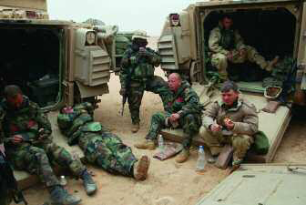
Controlling Ownership of the Media
Media Conglomerates
  Reevaluating the rules
Government Control of Content
  Control of broadcasting
  The Second Gulf War and “embedded reporters”
The Public’s Right to Media Access
Notes:
The big three networks (CBS, NBC, ABC) are owned by media conglomerates with several other holdings. Their profits are fueled in part by advertising revenues during programming.

Slide 20
Bias in the Media
Do the Media Have a Partisan Bias?
  Mainstream media try to practice objectivity
  But public thinks press is biased
  Advocacy media is intentionally biased
A Commercial Bias?
  Is the priority to inform or make a profit?
  Usually means a focus on infotainment
Agenda Setting
  Tells the audience what to think about
Notes:
Advocacy media are at both ends of the political spectrum, although far more identify themselves as conservative than liberal.

Slide 21
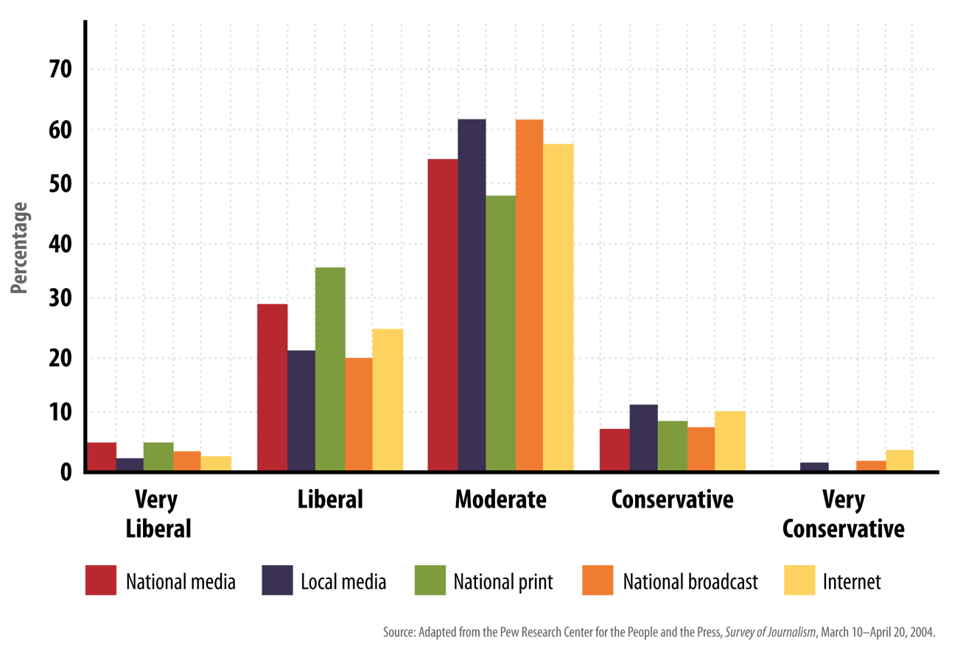
The Politics of the Press: How Reporters and Broadcasters Describe Themselves

