Slide 1
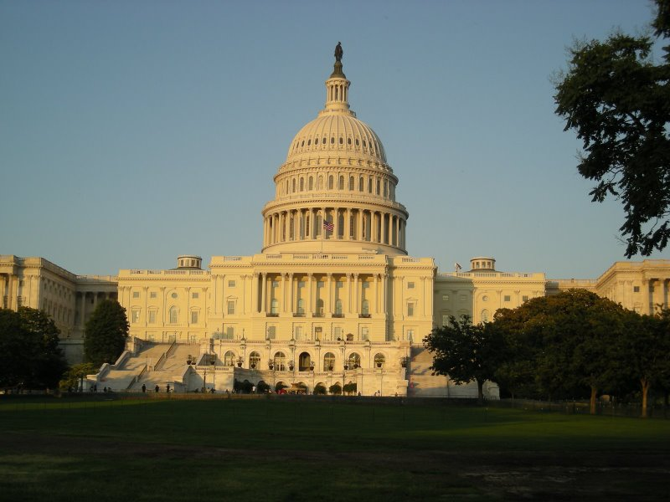
Political Participation

Slide 2
Political Parties
A political party is a group of like-minded individuals who work together to win elections and control government
Political Socialization is the process of identifying with a party: Family, education, beliefs, jobs, socioeconomic status, ethnicity and major events can all play a role in your party identification
What do parties do?
Recruit candidates
Organize and campaign to win elections
Hold conventions
Create the platform or major beliefs
Act as a watch dog on each other
*Parties are organized at the local, state and national levels.

Slide 3
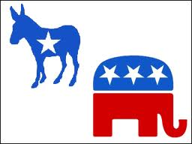
The American Two Party System
The US has a winner take all system, meaning there is not a reward for taking second place
The US has single member districts, only one person per district
Historically we have had two parties and that has created tradition

Slide 4
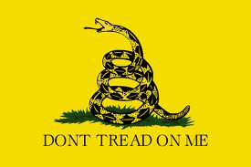
Third Parties
Third parties do exist, but it is difficult to get on the ballot and they face financial problems as well
Third parties can introduce new ideas, put issues on the agenda and play a spoiler role because they can take up popular votes
Examples of Third Parties:
Green
Tea
Constitutional
Libertarians
Socialist
Communist

Slide 5
Interest Groups
An interest group is an organization of people who share a common interest and work together to promote their beliefs and influence government
The difference between an interest group and a political party: Political parties want to win elections and are the voice of their constituency, interest groups care about their issue and influencing policy
Types of interest groups:
Non-Economic Groups:
Public groups
Single-Issue groups
Ideological groups
Governmental groups
Economic:
Business groups
Labor groups
Agricultural groups
Professional groups

Slide 6
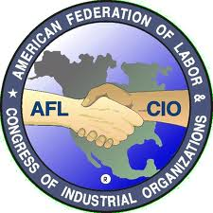
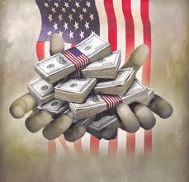
Strategies Interest Groups Use
Lobbying
Gain access
Persuasion
Evidence, information and research
Material Incentives
Money to educate
Contributions
Campaign finance
Organization
Protests and rallies
Litigation
Court cases

Slide 7
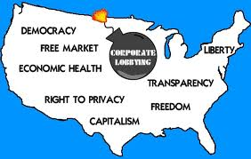
Lobbying
Inside Game
Attempt to gain persuade government through direct contact
Outside Game
Convince ordinary citizens to apply pressure
Raise public awareness
Voter registration drives
Grass roots-organize the people to accomplish a goal

Slide 8
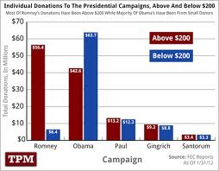
Campaign Finance
Interest Groups are not allowed to donate to campaigns directly
Political Action Committee-PAC
Theoretically Independent
Solicit money from group members to donate to parties and candidates
$5,000 to a candidate, $10,000 in an election cycle
$15,000 a year to a party
Can support as many candidates as they want
Hard Money
Money raised and spent to elect candidates
Reported
Soft Money
Money given for party building activities
Campaign Finance Reform Act
Bans soft money to National Party
Limits time period to run issue ads
Federal Election Commission-FEC
Administers Federal law in regards to election
Places limits on campaign contributions
Provides disclosure requirements of financial data

Slide 9
Voting
The best way to participate is by voting
States administer elections
Office-group ballot: candidates grouped by office
Party-column ballot: candidates grouped by party
Split ticket voting: vote for any candidate
Straight ticket voting: vote for a single party
Absentee voting: vote before the election
Voting by mail and online
Primary elections: intra party election to narrow candidates
Closed-open to party members only
Open-open to any eligible voter
Voter Turnout in America is Traditionally low:
Hard to register
It is inconvenient to vote
The parties are too similar
Time Zone fall out
Apathy
What impacts whether a person votes?
Age
Wealth
Education
Race
Ethnicity
Gender
Religion
Major events
Geography
Party Identification

Slide 10
Amendments and Laws that have had an impact on voting
Suffrage
The ability to vote
15th Amendment
Right to vote shall not be denied by U.S. or by any state on account of race, color or previous servitude
19th Amendment
No person can be denied the right to vote on account of sex
24th Amendment
Outlawed the Poll Tax
26th Amendment
Voting age is 18
Voting Rights Act of 1965
Further protected minority voting rights
Led to an increase in African American voter turnout

Slide 11
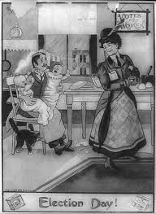
Political Cartoon Analysis

Slide 12
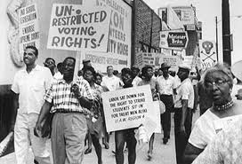
Photo Analysis

