Slide 1
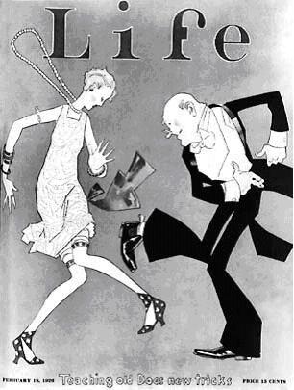
THE ROARING TWENTIES
LIFE & CULTURE IN THE 1920S

Slide 2
1. WOMEN’S ROLES, RIGHTS/ Flapper
After the uproar of World War I, Americans were looking for a little fun in the 1920s.
Flashy & Provocative
Women were independent and achieving greater freedoms.
Example: right to vote, more employment, freedom of the automobile
Chicago 1926

Slide 3
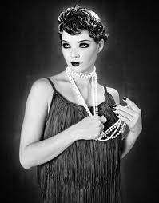
WOMEN’S ROLES/RIGHTS
19th Amendment
New meaning of womanhood
Cosmetics
Education

Slide 4
Flapper
Challenged the traditional view of women
Revolution of manners and morals.
A Flapper was an emancipated young woman who embraced the new fashions and urban attitudes.
Slang
Rejected by elders

Slide 5
2. Prohibition/Organized Crime

Slide 6
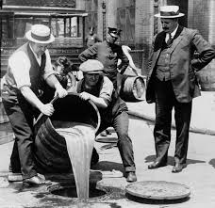
Prohibition
18th amendment in 1920.
Launched era known as Prohibition
Illegal to make, distribute, sell, transport or consume liquor.
21st amendment passed in 1933 repeals the 18th amendment

Slide 7
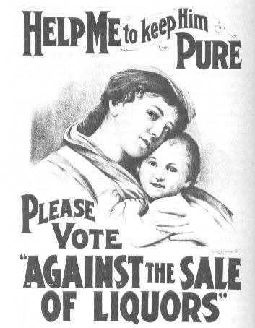
Poster supporting prohibition

Slide 8
Prohibition
Temperance Movement

Slide 9
Organized Crime
Prohibition contributed to the growth of organized crime in every major city
Al Capone –
Chicago, Illinois
famous bootlegger
“Scarface”
60 million yr (bootleg alone)
Capone took control of the Chicago liquor business by killing off his competition
Talent for avoiding jail

Slide 10
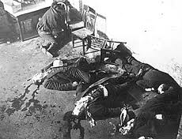
Organized Crime
Bootlegging
Bank robbers
Violence
St. Valentine’s Day Massacre

Slide 11
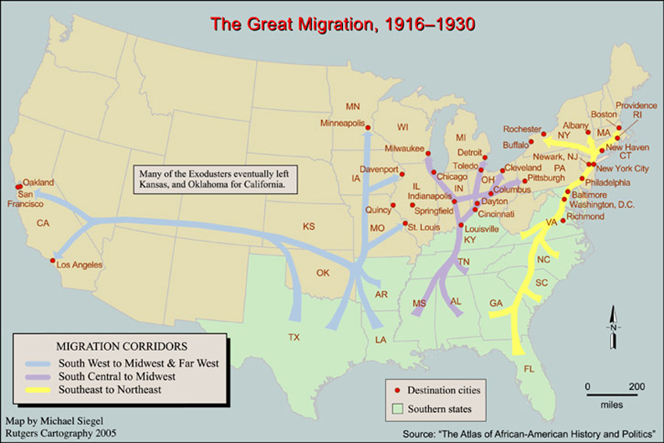
3. Urban Migration/ Harlem Renaissance/ Racial Tension

Slide 12
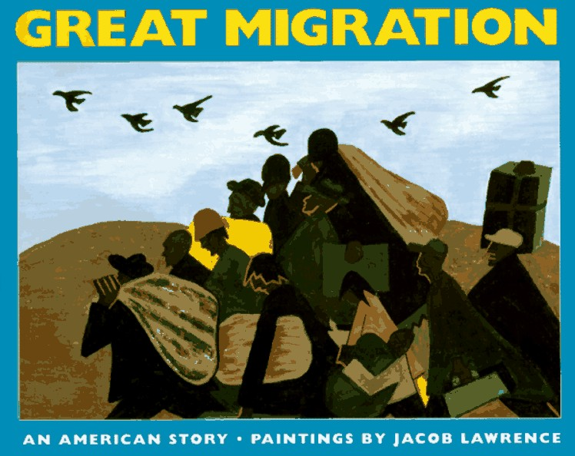
Urban Migration
1910-1930
1.5 million African Americans moved from the rural South to the Urban North
Settled on common communities
South Side of Chicago
Harlem

Slide 13
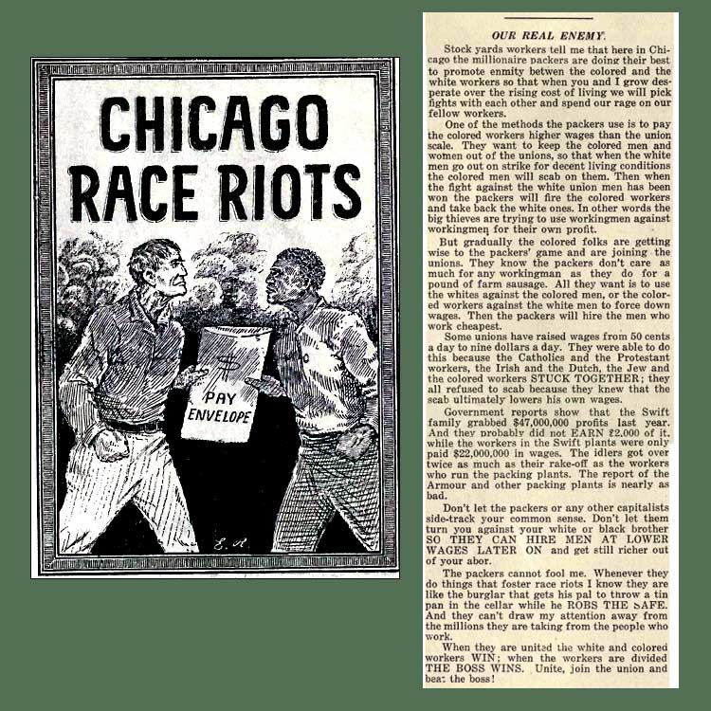
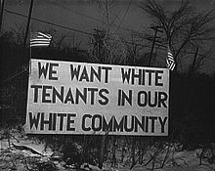
Racial Tension
Chicago Race Riot of 1919
Neighborhood discrimination
Workers replaced by returning WWI veterans
Workers do not receive equal wages

Slide 14
The Harlem Renaissance
During the Great Migration thousands of African Americans moved north to large industrial cities
1920:
5 million of the nation’s 12 million African Americans (over 40%) lived in cities
Migration of the Negro by Jacob Lawrence

Slide 15
The Harlem Renaissance
Harlem, NY became the largest black urban community
Harlem suffered from overcrowding, unemployment and poverty
Home to literary and artistic revival known as the Harlem Renaissance

Slide 16
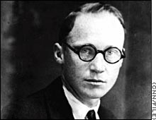
4. Scopes Monkey Trial
In March 1925, Tennessee passed the nation’s first law that made it a crime to teach evolution
The ACLU promised to defend any teacher willing to challenge the law – John Scopes did
Scopes was a biology teacher who dared to teach his students that man derived from lower species

Slide 17
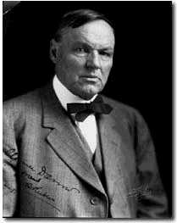
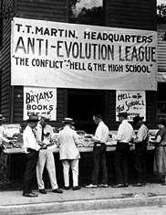
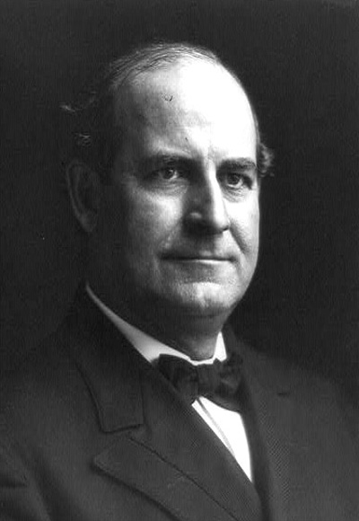
Scopes Monkey Trial
Creationism vs. Evolution
Fundamentalism vs. Modernity
William Jennings Bryan vs. Clarence Darrow
Darrow

Slide 18
5. Jazz and Entertainment
Even before sound, movies offered a means of escape through romance and comedy
First animated with sound: Steamboat Willie (1928)
By 1930 millions of Americans went to the movies each week
Walt Disney's animated Steamboat Willie marked the debut of Mickey Mouse. It was a seven minute long black and white cartoon.

Slide 19
Jazz
The Jazz Age
Music –
Bessie Smith & Louis Armstrong
Great Gatsby
Dance Marathons
New Dance Moves –
The Charleston
Waltz
Foxtrot
Tango & more

Slide 20
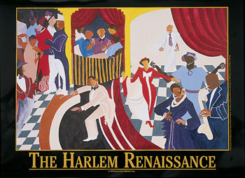
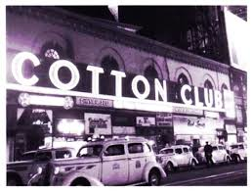
Jazz
Entertainment
Owned by white owners
Staffed by African American workers and musicians
Open to whites only

Slide 21
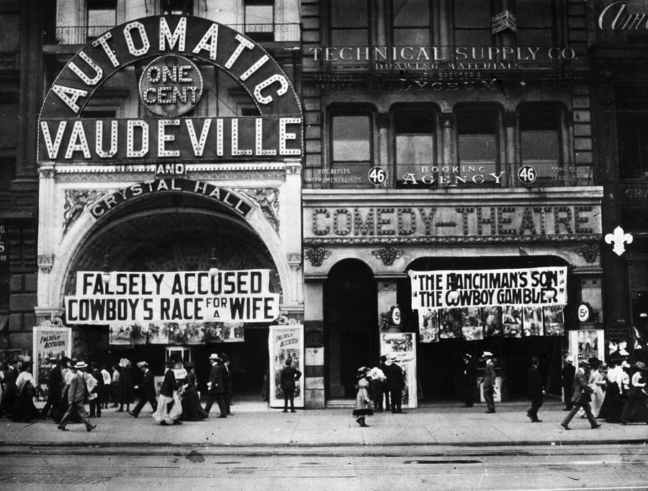
Entertainment
Disposable time
Disposable income
In 1929, Americans spent $4.5 billion on entertainment. (includes sports)
Other stars emerge from the movies, comedy, and more
Baseball
Professional and college football
Boxing
Vaudeville and Ragtime
American Heroes

Slide 22
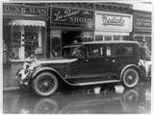
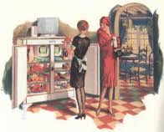
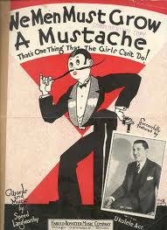
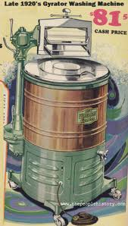
6. Henry Ford/ American Consumerism

Slide 23
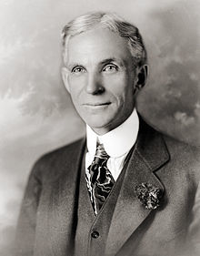
Henry Ford
Henry Ford
Founder of the Ford Motor Company
Assembly line innovator
Inventor of the Model T
Offered credit

Slide 24
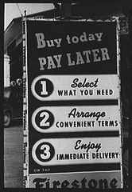
American Consumerism
Buy Now Pay Later
Changing attitude toward debt
75% of Radios
60% of automobiles
Electric razors
Refrigerators
Vacuum cleaner
Radio
Car
Cosmetics/ perfumes

Slide 25
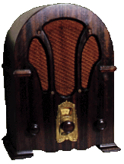
7. Radio/ Advertising
Although print media was popular, radio was the most powerful communications medium to emerge in the 1920s.
News was delivered faster and to a larger audience.
Americans could hear the voice of the president or listen to the World Series live.

Slide 26
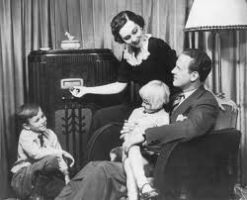
Radio
History of Radio
Advertizing techniques?
Boost selling of consumer goods?

Slide 27
Advertising
Name Brands
Selling lifestyle
Reaching the illiterate

Slide 28
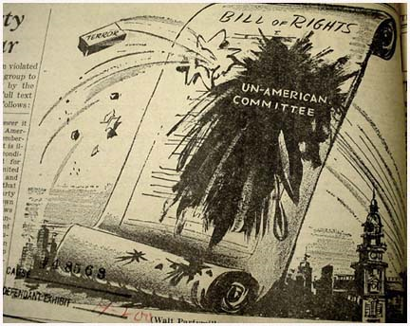
8. The Red Scare
After WWI, many fear the spread of Communism.
US Attorney General Palmer begins deporting immigrants that ‘seem to’ threaten democracy.
Many people panic while others are outraged

Slide 29
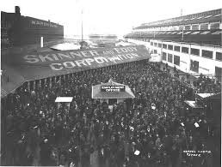
Red Scare
Post WWI economic recession
Seattle General Strike
May Day Bombs
Investigate un-American activities
Deport Russian nationals

