Slide 1
INDUSTRIAL REVOLUTION

Slide 2
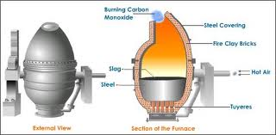
INDUSTRIAL INNOVATIONS
STEEL
Before the mid 1800’s it was expensive to convert iron ore
In the mid 1850’s Henry Bessemer developed a method of making steel that burned off the impurities in molten iron ore with a blast of hot air
The Bessemer Process produced more steel in one day than the older process did in a week
American steel production increased from 15,000 tons in 1865 to 28 million tons by 1910
IMPACT OF STEEL
Urbanization or the growth of cities
Railroad industry grew
Bridges, skyscrapers were built
Coal and Iron Ore mining increased

Slide 3
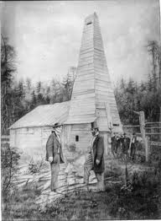
INDUSTRIAL INNOVATIONS
OIL
Edwin Drake used a steam engine to drill for oil in 1859
The process to refine oil led to the development of kerosene, internal combustion engine, horseless carriage, automobile and airplanes

Slide 4
RISE OF BIG BUSINESS
CAPITALISM
Private business run industry and competition drives how much goods cost and how much workers are paid
LAISSEZ FAIRE
No government intervention, let people and businesses compete in a free market society
CORPORATION
Organizers raise money by selling shares of stock in a company. Stockholders receive a percentage of the profits, known as dividends
TRUST
Group of companies turn control of their stock to a common board of trustees. Trustees then run all companies as a single enterprise, reducing overproduction
MONOPOLY
A company has complete control over the price and quality of a product, forcing all others out of business
SOCIAL DARWINISM
Proposed by Herbert Spencer and adapted from Charles Darwin’s theory of natural selection and evolution. Society progresses through natural competition. The fittest people, businesses or nations should and would rise to positions of wealth and power

Slide 5
ROBBER BARONS VS CAPTAINS OF INDUSTRY
“Robber baron" was applied to powerful nineteenth-century industrialists who were viewed as having used questionable practices to amass their wealth.
“Captains of industry" were business leaders whose means of amassing a personal fortune contributed positively to the country in some way.

Slide 6
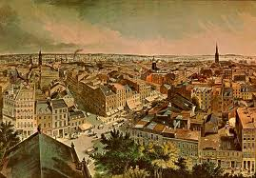
URBANIZATION
Before the Industrial Revolution cities were compact
New technological innovations and immigration began to transform cities
Between 1865 and 1900 the percentage of Americans living in cities went from 20% to 40%

Slide 7
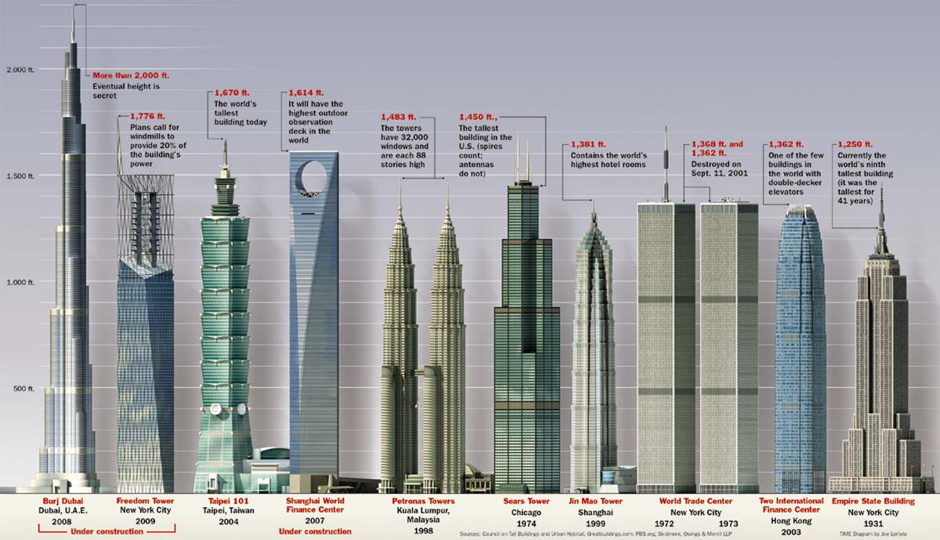
IMPACT OF INDUSTRIALIZATION
Skyscrapers
Industry and factories offered new opportunities to working class men and women
Living conditions for the working class were made worse by housing shortages and rising cost of rent
Tenements-poorly built apartment buildings that housed 1.6 million people in New York, nearly half the cities population
Settlement House were community service centers in poor neighborhoods. Jane Adams started Hull House in Chicago, to educate, provide job training and day care

Slide 8
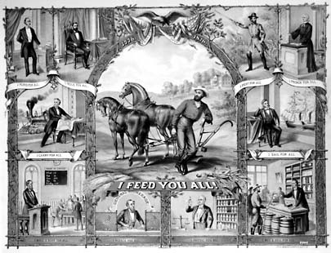
POPULIST PARTY
A coalition of farmers, labor leaders and reformers started the Populist Party in 1892
Goals
Graduated Income Tax
Bank Regulation
Government ownership of railroad and telegraph companies
Free and unlimited coinage of silver
Restriction on Immigration
Shorter work day
Voting reforms

