Slide 1
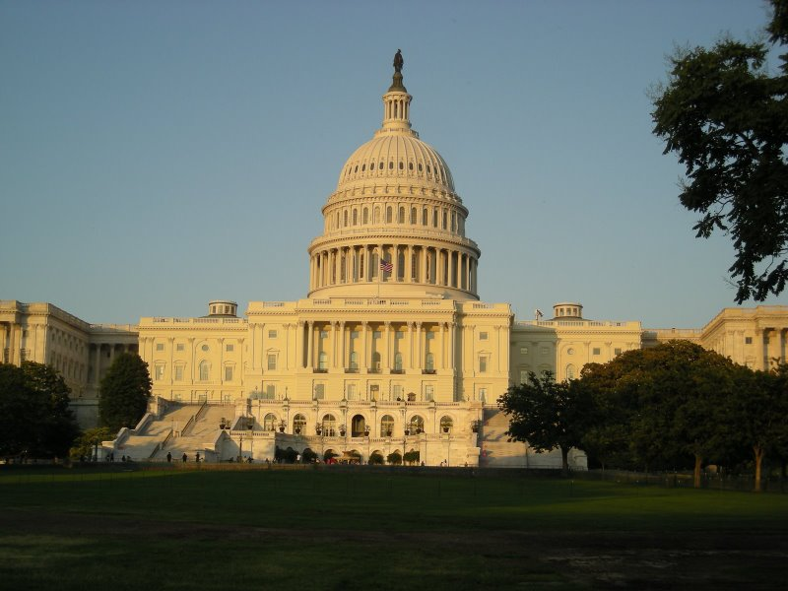
LEGISLATIVE BRANCH

Slide 2
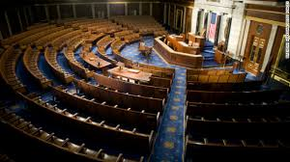
Legislative Facts
Why we have a bicameral Legislature?
Practical
Traditional
Checks and Balances
A term of Congress is two years and is numbered consecutively
20th Amendment changed start date to 3rd day of January every odd year
A session of Congress is the period of time during each year where congress assembles and conducts business
Congress works most of the year, but can adjourn with approval of both houses
Prorogue-President can adjourn Congress if they do not agree, never happened
President can call special sessions in times of emergency

Slide 3
Bi-cameral Houses
House
Representation based on population.
Each state has a different amount
Utah has four seats
California has the most with 53
Each state has at least one
Senate
Equal representation for each state.
Each state has two.
Considered to be the upper house of Congress

Slide 4
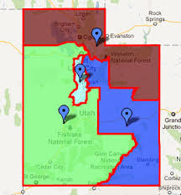
House of Rep’s
Census- population for each state is adjusted every ten years and Reapportionment takes place
Redistricting- Creates state boundaries for House district’s.
Gerrymandering is when district lines are drawn to benefit 1 group over another.

Slide 5
Congress Qualifications and terms
House
25 years old
Citizen of the U.S. for past seven years
At the time of election inhabit the state they are elected from.
Elected to two year terms
No term limits
Senate
30 years old
Citizen of the U.S. for past nine years
At the time of election must be a citizen of the state they are elected from
Elected to six year terms
No term limits

Slide 6
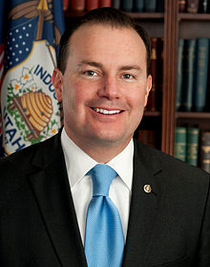
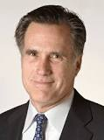
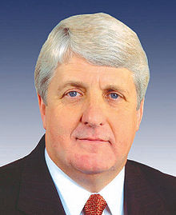
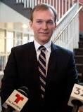
What do members of Congress do?
Represent the People by casting votes
Trustee-Decide on the merits
Delegate-Agent of the people
Partisan-Party line
Politico-Combine elements and balance all of the above
Serve on Committee’s

Slide 7
Types of Committees
Standing
Permanently established
Look at Legislation in a certain area
Most important because they can introduce legislation
Select
Appointed for a limited time and purpose
Does not introduce legislation
Only last a year or two

Slide 8
Committees Cont.
Joint
Have both Senators and House members.
Set up to focus on major social issues.
Set up to conduct business between both houses of Congress
Conference
A type of joint committee.
Set up to resolve differences on the same version of a bill in both houses.

Slide 9
Demographics and Characteristics of the 116th Congress
Partisan Composition
House-235 D, 199 R
Senate-53 R, 45 D, 2 I
Gender
House-332 M, 102 F
Senate-75 M, 25 F
Ethnicity
House-326 C, A.A. 52, Hispanic 40
Asian 12, N.A. 4
Senate-91 C, A.A. 3, Hispanic 4, Asian 3
Average Age
58.6, same as 115th Congress and a year older than 114th Congress
Professions
*Nearly all have a college education
*Career Politicians
*Business
*Law
Length of Service
House-8.6 Years
Senate-10.1 Years
Religion
Most are Protestant and Catholic
10 Mormons
34 Jews
2 Buddhist
3 Muslims
3 Hindu
18 Unaffiliated or did not answer

Slide 10
Privileges and Benefits of Congressmen
Salary
$174,000
Speaker-$223,500
Senate Pro Temp and Leaders-$193,400
Tax deductions for 2 residences
Travel allowances
Health benefits and Life Insurance
Pension plan
Staff in DC and State
Franking Privilege
Freedom of Debate

Slide 11
Powers of Congress
Expressed
Written in Article one section eight of the Constitution. (Quiz on these powers next time).
These can’t be taken away.
Implied
Very controversial, and fall under the necessary and proper clause in Article one section eight of the Constitution.
Examples-Federal Reserve, Military Academies, Money on education.

Slide 12
Powers Cont.
Impeachment
Shared by both the House and the Senate
House brings about charges of impeachment
Senate tries impeachment
A President can be impeached and not removed from office.
Presidents Impeached
Andrew Johnson-Congress did not like his ideas of Reconstruction
Bill Clinton- Lied under oath to Congress (Monica Lewinsky)
Richard Nixon- Watergate…He resigned instead (not officially impeached).

Slide 13
Powers Continued
Non-Legislative
Amendment Process
Electoral Duties
Fill vacancies
Break a tie for the Presidential election
Executive
Confirm nominees and treaties
Investigatory
Baseball steroid scandal, BP Oil Spill.

Slide 14
Powers Continued
Denied Powers
Writ of Habeas Corpus- People must be brought before a judge and have charges read to them.
Passing Bill of Attainder- People can’t be punished without a trial.
Passing of Ex Post Facto Law- People can’t be punished for a an action that occurred before it was illegal.

