Slide 1
Progressive era
REFORM AND CHANGE

Slide 2
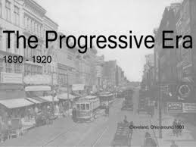
PROGRESSIVE GOALS
Protect Social Welfare
Promote Moral Improvement
Regulate Economic Activity
Foster Efficiency

Slide 3
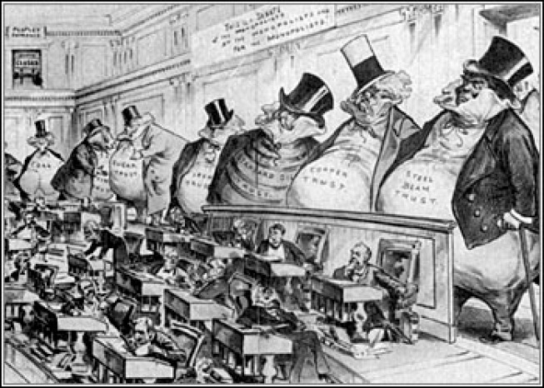
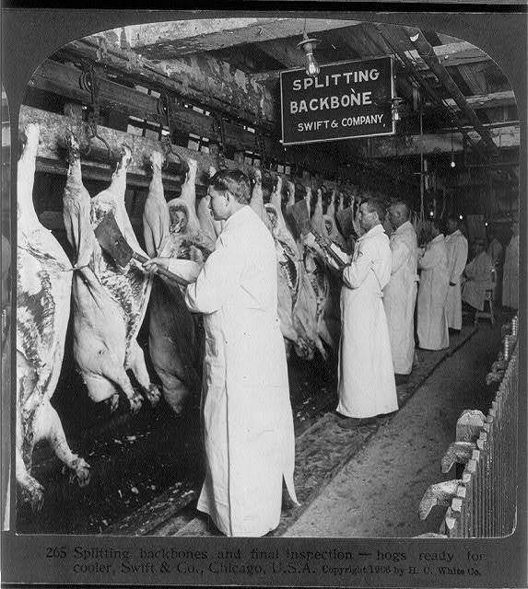
Labor legislation
Sherman Anti-Trust Act 1890
National Reclamation Act 1902
Interstate Commerce Commission
Hepburn Act 1906
Pure Food and Drug Act 1906
Meat Inspection Act 1906
Department of Labor

Slide 4
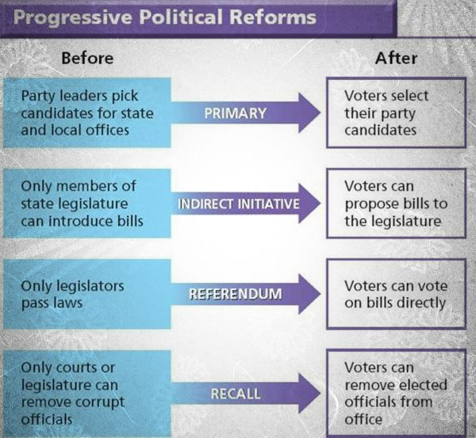
Political reforms
16th Amendment
Graduated Income Tax
17th Amendment
Direct Election of Senators
Referendum
Legislation put on the ballot for public vote
Recall
Removing an elected official by petition and vote
Initiative
Introducing legislation by petition and public vote

Slide 5
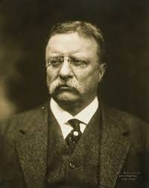
Progressive presidents
Theodore Roosevelt became president in 1901 after the Assassination of President Mckinley
He wanted to fight class distinctions
Wanted a “Square Deal”
Limit Trusts
Promote public health
Improve Working Conditions
Launched a Trust busting campaign where his administration brought suit 44 times
He encouraged Railroad Regulation with the Elkins and Hepburn Act
He helped arbitrate the United Mine Workers Strike in Pennsylvania 1902
Promoted safety and sanitation in food production
Promoted the Environment

Slide 6
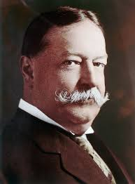
Progressive presidents
William H. Taft became President in 1908
He brought suit and busted 90 trusts in 4 years as President
He increased power to the ICC in 1910
He helped create the Department of Labor
Helped establish the 8 hour work day
Helped to negotiate and create mine safety laws
Instrumental in helping get the 16th Amendment passed
President Taft was not seen as a good Republican
Election of 1912: Republican was Taft, Democrat was Woodrow Wilson, Bull Moose was Teddy Roosevelt, Socialist was Eugene Debbs
Republicans were split between Roosevelt and Taft allowing Woodrow Wilson to win the election of 1912

Slide 7
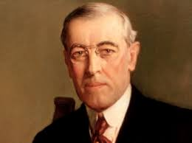
Progressive presidents
Woodrow Wilson wins 435 electoral votes an becomes President in 1912
Creates The New Freedom
Lower Tariffs
Banking reform with the Federal Reserve
Clayton Anti-Trust Act which gives more power to the Sherman Act and more power to workers and labor unions
Helps to create the Federal Trade Commission to help regulate corporations
19th Amendment is started during his Presidency

Slide 8
Civil Rights begins
Many Civil Rights activists believed that the Progressive Presidents and other members of Government were not doing enough for Civil Rights
NAACP is created in 1909 with the goal to end racial discrimination
National Urban League is created to fight for racial equality
Guinn vs. United States is the first NAACP victory and ends the Grandfather clause

Slide 9
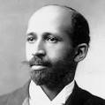
WEB Dubois vs. Booker T. Washington
WEB Dubois wanted African Americans to be educated and active in Politics and protest for equality
Booker T. Washington created the Tuskegee Institute and advocated African American education and entrepreneurship to fight against discrimination

Slide 10
Native Americans
Dawes Act of 1887
Caused Natives to lose land and many fell into poverty conditions
Society of American Indians
Organization that fought for equal rights for Native Americans

