Slide 1
World War I
US Home Front and The End of the War

Slide 2
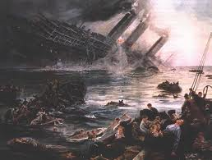
United States Declares War
US Declares War in 1917
Senate declares April 4
House declares April 6
6 Senators and 50 Reps. Were not in favor of War
Selective Service Act of 1917
Men 21-30 had to register with the selective service
24 million registered, 2.8 million were drafted

Slide 3
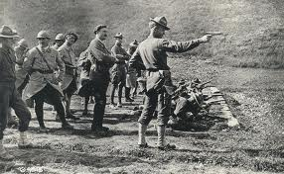
United States Prepares for War
Military Training
Training camps were built, people went under medical tests, trainees learned hand to hand skills, drilling and went to the rifle range
Equipment
Each soldier was assigned a doughboys pack that contained ammunition, canteen, gas mask, tent, poncho, socks, ID tags, compass, flashlight and rations
Convoy System
General John J. Pershing led the American Expeditionary force to Europe
Supply and transport ships were escorted by military ships

Slide 4
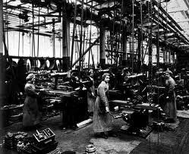
Minorities Involved in the War
African Americans and other minorities were in segregated units
There was a lot of discrimination-African Americans in many cases could only serve as cooks
Women joined the war effort in many ways
Went to work in the factories and fields
Organized youth leadership(girl Scouts)
Worked as nurses for the Red Cross

Slide 5
Government Policies During WWI
How did the US pay for the War?
War bonds, loans, increased taxes, victory bonds
How did the US conserve resources?
Plant victory gardens, meatless, heatless and wheat less days, control prices of food and fuel
National War Labor Board
Organized labor unions to fight for worker rights and arbitrated disputes
War Industries Board
Government’s central agency that regulated all war activities
Allocated materials, established priorities and set prices
Committee on Public Information
Carried out the propaganda campaign-try to persuade people to support the war and hate the enemy

Slide 6
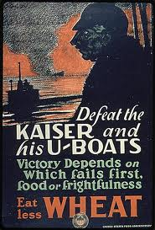
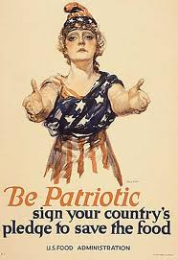
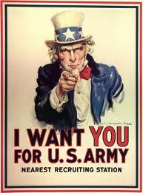
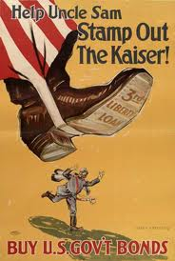
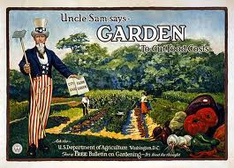
World War I Propaganda

Slide 7
Social Problems During WWI
Great Migration
Higher wages and more jobs brought African Americans and Hispanics from the South to the North
Influenza Epidemic
WWI claimed the lives of 16 million people but Influenza claimed nearly 50 million world wide
Influenza affected 25% of the US population
Espionage and Sedition Acts
These laws made it illegal to go against the war effort in any way
Supreme Court established the “clear and present danger rule”
It is alright to place limits on individual rights to protect national security

Slide 8
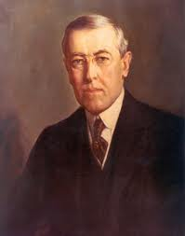
President Wilson’s 14 Points
He gave this speech January 8, 1918
Freedom of the seas
Armament reduction
Open diplomacy
Free trade
Popular Sovereignty
League of Nations

Slide 9
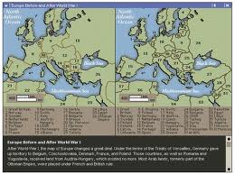
Treaty of Versailles
Big Four
US, Britain, France and Italy
What did the Treaty do?
Established 9 new countries like Poland, Czechoslavakia and Yugoslavia
Carved 4 areas out of the Ottoman Empire
Demilitarized Germany by destroying its Air force and shrinking its army to 100,00
Required Germany to return the Alsace-Lorraine to France
Germany had to pay war reparations of 53 billion to the allies
Germany had to sign the war guilt clause, which made them responsible for the war
League of Nations created
Weaknesses of the Treaty
Treaty humiliated Germany by making them sign the War Guilt Clause
Bolshevik Government in Russia was mad when they were not invited to the Peace conference
Instability resulted in Europe because they ignored Popular Sovereignty

Slide 10
Why the US has Problems with the Treaty of Versailles?
The Allies do not like President Wilson's 14 Points
France wanted to prevent future invasions
British wanted money
Italy wanted land
Everyone likes the League of Nations
US Senate does not approve the Treaty
Many US leaders feel the treaty threatens US foreign policy
Treaty fails in the Senate twice
The United States never joins the League of Nations
Legacy of the War
Many Germans were shocked by the cease fire and they were very upset about the Treaty of Versailles
Germany is hit hard by a huge depression
The Treaty and the depression weaken Germany, which opens the door for Adolf Hitler to gain power

